Slide 1
Texas EMS Medical Director’s Survey & Medical Direction from the Provider’s Perspective
An Assessment of Online and Offline
Medical Direction in Texas
Anthony Gilchrest, MPA, Charles Macias, MD, MPH, Manish Shah, MD
This project has been funded by the Emergency Medical Services for Children (EMSC) State Partnership Grant from the Health Resources and Services Administration (HRSA) H33MC11305

Slide 2
BACKGROUND
Universally available online medical control is absent in 38% of Emergency Medical Services (EMS) agencies in Texas
Barriers to online medical control in Texas have not been previously described
76% of EMS agency leaders (non-physicians)desire online medical control from a base station at a regional children’s hospital
75% of EMS agency leaders (non-physicians) would use EMS for Children (EMSC)-created evidence-based (EB) pediatric protocols
No data exists on current utilization of pediatric–specific online medical control in Texas
Medical directors’ perspectives on online and offline medical direction in Texas have not been previously assessed

Slide 3
OBJECTIVES
To identify common barriers and explore acceptability of potential solutions for online medical control
To describe EMS providers’ and medical directors’ experiences with medical direction
To measure current utilization of pediatric online medical control
To provide the medical directors’ perspective on regional pediatric online medical control and written protocols

Slide 4
METHODS
Study Design and Setting:
Cross sectional survey of EMS providers attending 2011 Texas EMS Conference
Cross sectional online survey of all medical directors of 911-responding EMS agencies in Texas

Slide 5
METHODS
Inclusion Criteria:
EMS personnel currently working or volunteering for a ground transport ambulance service in Texas
Physician medical directors for 911-responding ground ambulance services in Texas
Data Analysis
Descriptive statistics were used to report frequency of responses
Identical and similar questions from each survey were grouped by question type and presented in side-by-side comparison

Slide 6
RESULTS
EMS Provider Survey
105 EMS providers surveyed
16 declined; 5 excluded
84 (80%) surveys analyzed
Agency Representation
93% 911-responding EMS agencies
38% non fire-based, public 32% fire-based
14% private for profit
7% hospital-based
58% all paid
25% combination
15% all volunteer
90% Advanced Life Support (ALS)
38% rural; 30% urban;
25% suburban; 7% frontier

Slide 7
RESULTS
EMS Medical Director Survey
319 medical directors surveyed
3 declined; 14 excluded
127 (40%) surveys analyzed
59% have attended an EMS Medical Directors’ course
Agency Representation
43% fire-based
37% non fire-based, public 18% private for profit
17% hospital-based
11% non-profit
52% all paid
40% combination
5% all volunteer
94% ALS
61% rural; 36% urban

Slide 8
Agency Monthly Call Volume

Slide 9
Online Medical Control ALL PATIENTS
(Calls for medical advice other than routine notification)
Urban
Rural
24

Slide 10
Online Medical Control Pediatrics
(Calls for medical advice other than routine notification)
Urban
Rural
4

Slide 11
Percentage of Pediatric Calls

Slide 12
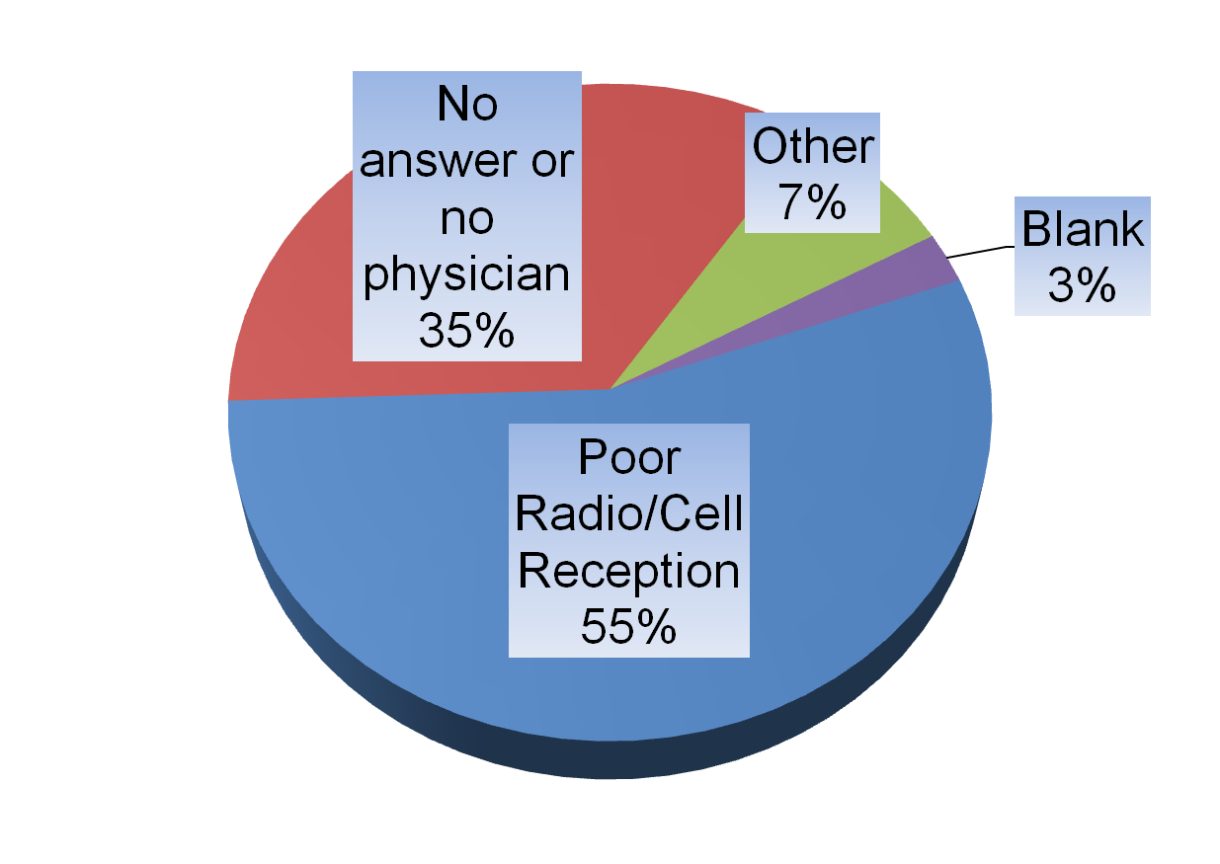
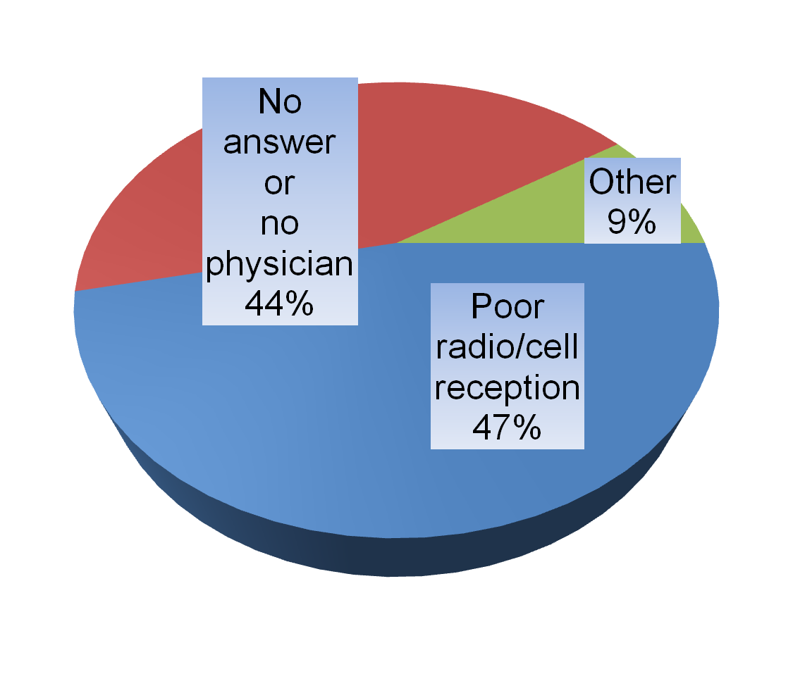
Causes for communication failures
EMS Providers
Medical Directors
Reported communication difficulties when attempting to contact online medical control
Reported causes for online medical control communication failures investigated by MD

Slide 13
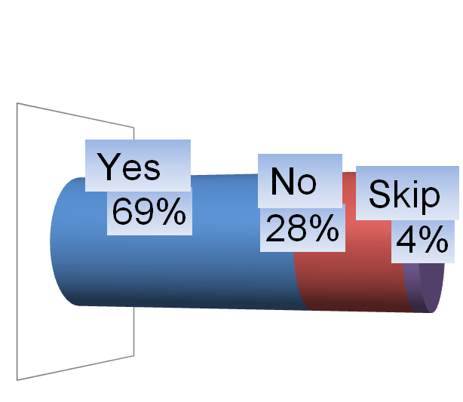
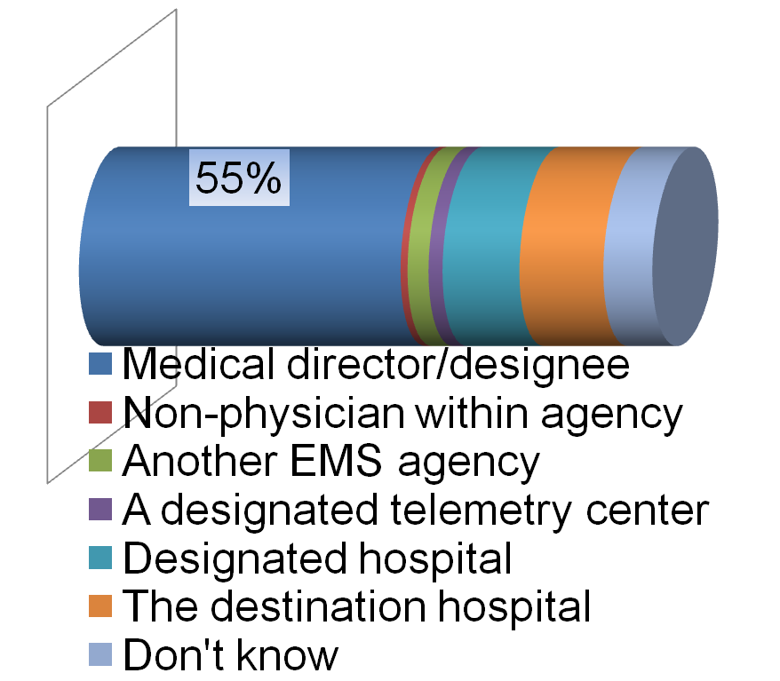
Primary source of medical control
EMS Providers
Medical Directors
Primary source of online medical control
Medical director or designee provides online medical control
14%
13%

Slide 14
Alternative source dynamics
Of those reporting that someone other than the agency medical director provides online medical control:
49% do not know skill/training of physician providing medical direction
43% reported that medical control physician would not know written protocols
14 % would not know training or skill level of EMS providers
80% report they do not receive QA/QI from physician/agency providing medical control

Slide 15
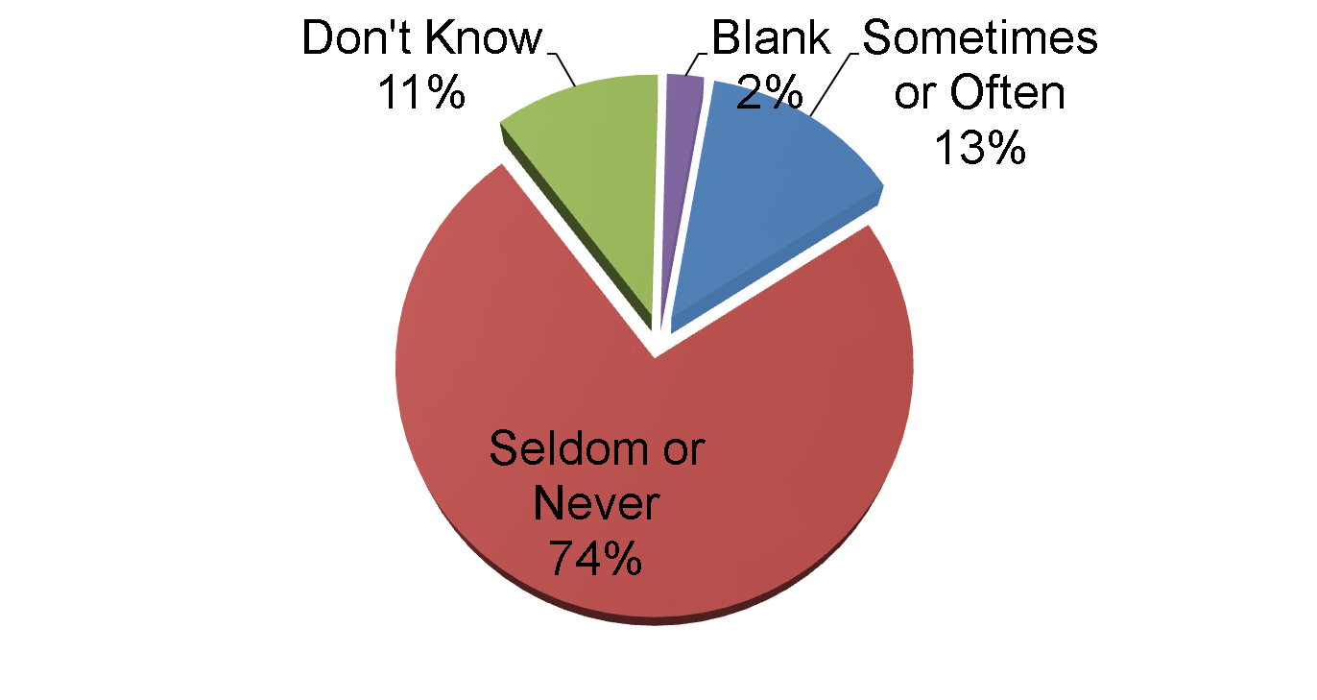
Protocol/order Discordance
EMS providers that received online orders that contradict written protocol

Slide 16
Pediatric medical direction
Medical Director Perspectives | Agree | Disagree | Don’t know
Standardized, EB regional pediatric protocols would improve quality of care | 79% | 5% | 9%
Pediatric online medical control from a pediatric emergency medicine (PEM) specialist has the potential to improve quality | 73% | 11% | 8%
Would consider utilizing online medical control from a base station at regional pediatric center | 72% | 9% | 11%
Would consider using EMSC created EB pediatric protocols | 82% | 3% | 8%

Slide 17
Pediatric medical direction
Perceived Barriers to Regional Online Medical Control
Medical Director Perspectives | Agree | Disagree | Don’t know
Varied protocols within a given region would be a significant barrier to regionalized online medical control | 63% | 15% | 14%
Varied EMS provider certification level/scopes of practice within a given region would be a significant barrier to regionalized online medical control | 59% | 21% | 13%

Slide 18
Medical Director Participation
EMS Providers’ Perspective
Reported Medical Director Participation | Agree | Disagree | Don’t Know
Participates in agency mass casualty incident and/or disaster training | 55% | 20% | 20%
Provides/participates in my continuing education | 61% | 20% | 14%
Provides feedback on critical calls | 68% | 14% | 13%
Regularly reviews run records | 62% | 15% | 19%
Investigates protocol violations | 70% | 7% | 19%

Slide 19
LIMITATIONS
Limited sample sizes
Selection bias for EMS provider survey: respondents at Texas EMS Conference were disproportionately ALS level providers
37% unknown or missing for monthly on-line volumes average

Slide 20
CONCLUSIONS
Common barriers to online medical control (OLMC) include
Poor cell phone and radio reception
No answer to call or no physician available
Someone other than the medical director or designated physician is frequently the expected resource for OLMC
Pediatric OLMC utilization (21%) is disproportionately higher than EMS pediatric transports (10%)
Calls for pediatric OLMC in the rural setting are rare
Standardized, evidence-based, regional pediatric protocols and base stations are strongly supported by medical directors
Notes:
Objectives:
To identify common barriers and explore acceptability of potential solutions for online medical control
To describe EMS providers’ and medical directors’ experiences with medical direction
To measure current utilization of pediatric online medical control
To provide the medical directors’ perspective on regional pediatric online medical control and written protocols
SUMMARY
Common barriers include
Poor cell phone and radio reception
No answer to call or no physician available
Medical directors and providers report similar experiences
Pediatric online medical control utilization (21%) is disproportionately higher than previously reported EMS pediatric transports (10%)
Calls for pediatric medical control in the rural setting relatively rare
Standardized EB regional pediatric protocols and regional pediatric base stations are strongly supported by medical directors

Slide 21
Next Steps
Continue to develop Pediatric Protocol Resource with EB literature summaries and guidelines for use in the creation of more standardized local and regional EB pediatric protocols
Work with GETAC committees, medical directors, EMS agencies, children’s hospitals and community hospitals to enhance current online medical control communication infrastructure

